Slide 1

MULTIPLEX BOOKING SYSTEM
Sharath Chandra Pendyala – 46336092
Rachana YL – 46336024
Mamatha Bandari – 46336121
Dharani Murugesan - 46335962
Harika Velagala - 46335942

Slide 2
Contents
Introduction
Problem statement
Purpose of the system and importance
Functional requirements
Non - functional requirements
Class diagram
Conclusion
Use case diagram
ER diagram
Challenges faced
Software Requirements
Entities
Sequence diagram
Future enhancements

Slide 3
This system is an integrated solution for multiplex booking system to enhance the real-time experience for booking the tickets. The primary goal is to allow the user to manage user profile and booking details as well as allowing admin to manage the show details.
INTRODUCTION

Slide 4
This platform allows the customers to:
Register and manage their user profile with ease.
Browse current and upcoming movie shows across multiple screens.
Book and cancel seats in real-time with just a few clicks.
Access detailed show information to plan their visit perfectly.
This platform allows the administrators simplify:
The publication of accurate show details.
Generation of comprehensive earnings report.
Efficient management of show times and seat availability.

Slide 5
Issues pertaining to outdated booking systems, limited online booking capabilities, insufficient real-time seat availability updates.
In today's entertainment landscape, the process of booking movie tickets at multiplexes continues to face critical challenges, impacting both customers and theater management.
Customers encounter hurdles such as complex and time-consuming booking procedures, a lack of real-time updates on seat availability and movie schedules.
PROBLEM STATEMENT

Slide 6
Windows 11 Operating System
Java Programming Language 17
Eclipse IDE 4.25.0
Spring Initializr
Spring Boot
Junit 5 & Mockito
Postman/Swagger
PostgresSql 15.1
Software Requirements

Slide 7
PURPOSE AND IMPORTANCE
Purpose:
Enables users to conveniently browse available movies, showtimes, and seating options.
Facilitates the selection and reservation of specific seats in the movie hall.
Updates the real-time information about the show details .
Importance:
Customer satisfaction
Accessibility
Enhanced user experience
User accounts

Slide 8
User Registration:
Allow new users to create profiles with personal details. Enable existing users to log in and manage their accounts. Secure authentication and account recovery options.
Show and Movie Query:
Provide real-time information on movie schedules and seat availability. Offer detailed views of movie descriptions, ratings, and actor information. Enable search functionality by movie name or showtime.
Seat Booking:
Facilitate the selection of seats and booking for various showtimes. Confirm bookings instantly and provide digital ticket options.
Functional
Requirements

Slide 9
Booking Management: Allow users to view or cancel bookings. Enforce cancellation policies and issue refunds where applicable. Update seat availability in real-time post-booking or cancellation.
Administrative Functions: Empower administrators to publish and update show details. Provide tools for generating and exporting earnings reports.
Facilitate the Data Management: Centralize storage of all user data, show details, and transaction records. Ensure data consistency across the booking system. Integrate with other systems for synchronized data flow..

Slide 10
Performance:
Fast response times for all user interactions, ensuring a seamless booking experience. Efficient handling of peak loads, especially during high-demand movie releases or special promotions.
Scalability:
Ability to accommodate an increasing number of users and data volume without degradation in performance. Flexible architecture to support future expansion or integration with additional services.
Non -Functional
Requirements

Slide 11
Reliability:
High system uptime, with minimal downtime for maintenance or updates. Effective error handling and recovery mechanisms to ensure continuous service availability.
Maintainability:
Ease of system updates and maintenance without significant downtime. Clear documentation and support for future upgrades or troubleshooting.
Compatibility:
Cross-platform functionality, ensuring consistent user experience across various devices and browsers. Integration capabilities with existing systems and third-party services.

Slide 12
Movies
Shows
Hall
User
Booking
Hall capacity
Booking details
Seat type
Earnings report
Show Availability
ENTITIES

Slide 13
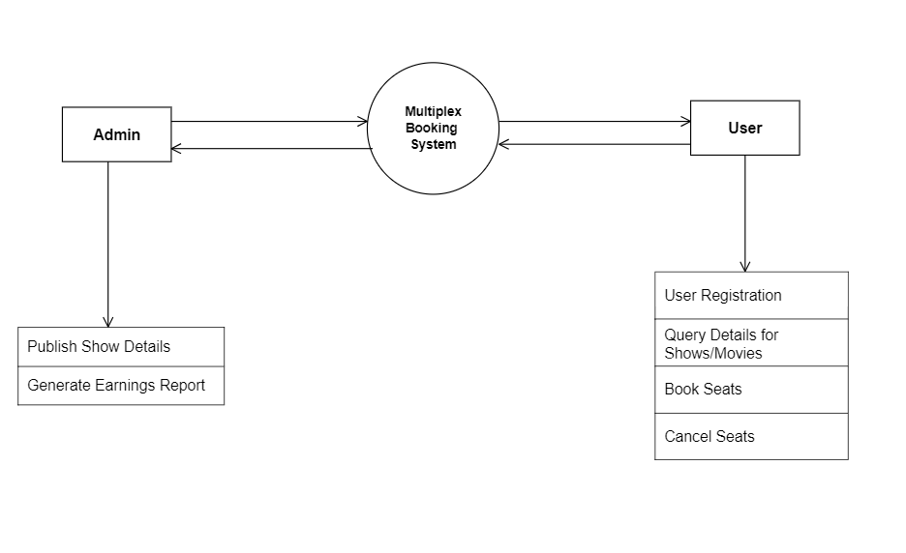
ARCHITECTURE

Slide 14
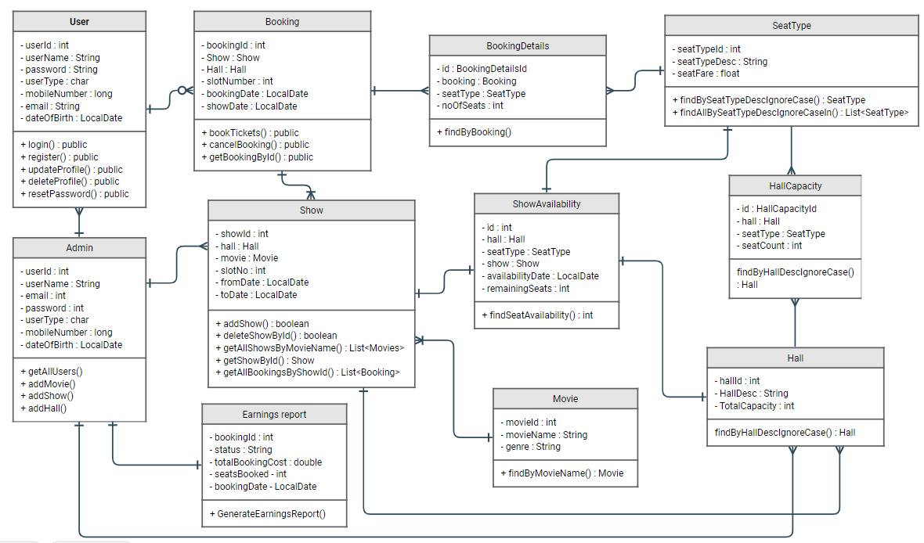
Class Diagram

Slide 15
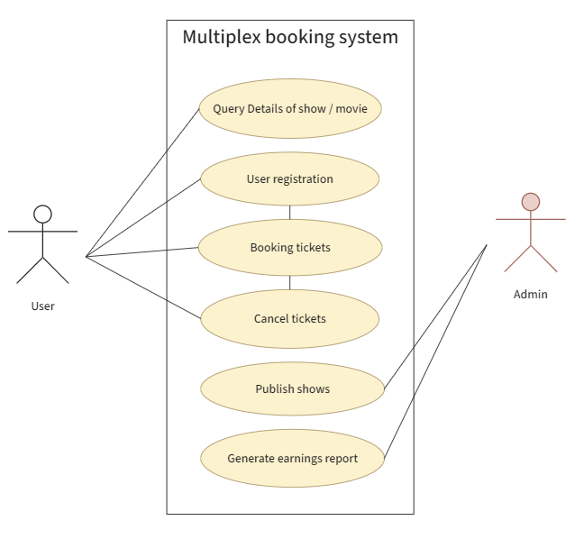
Use case diagram

Slide 16
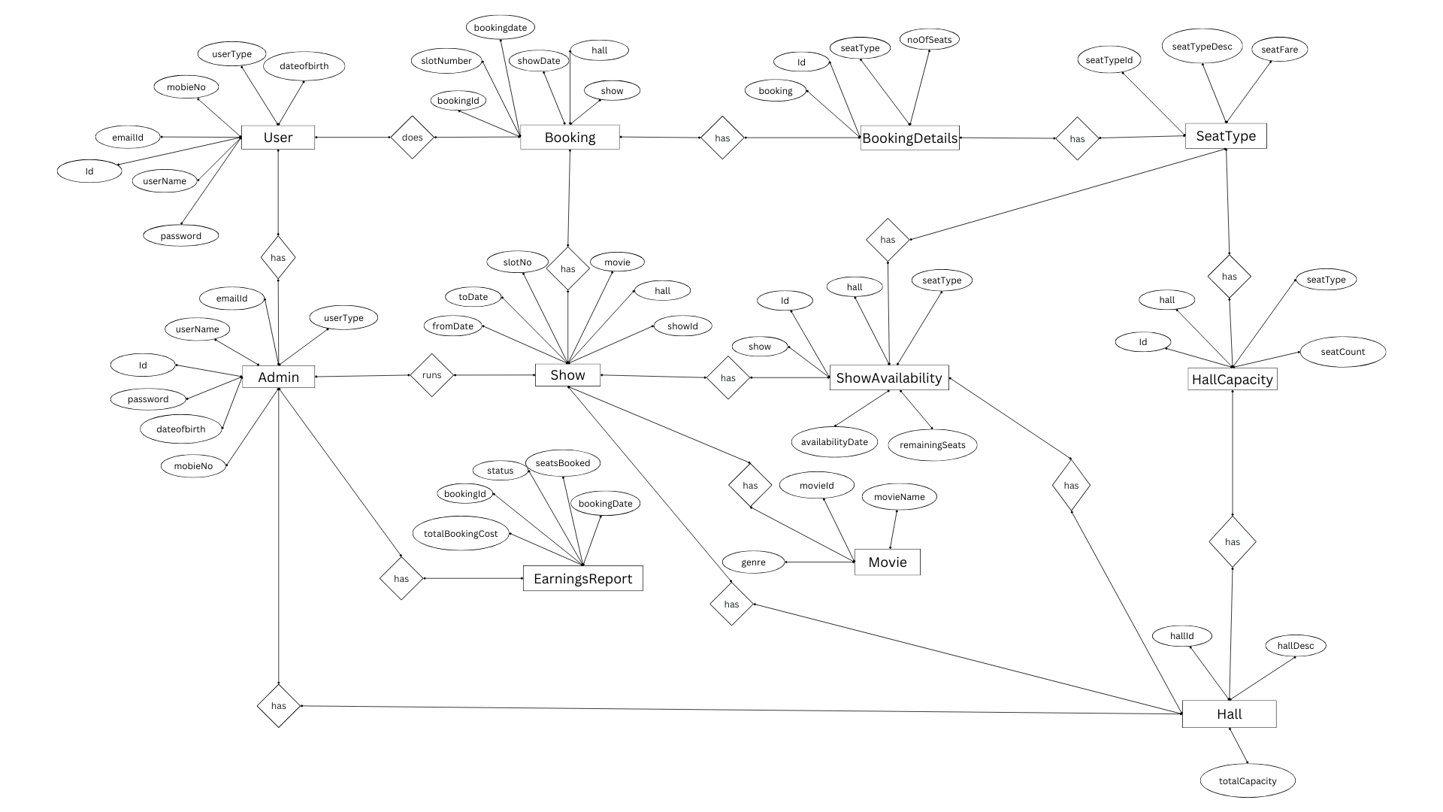
E R Diagram

Slide 17
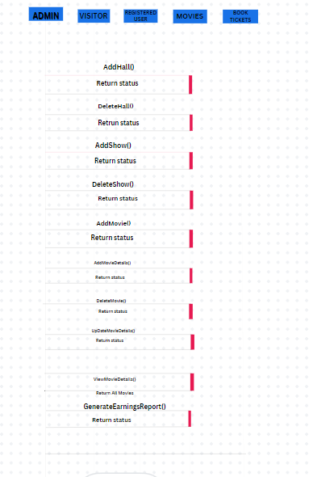
Sequence Diagram For Admin Flow

Slide 18
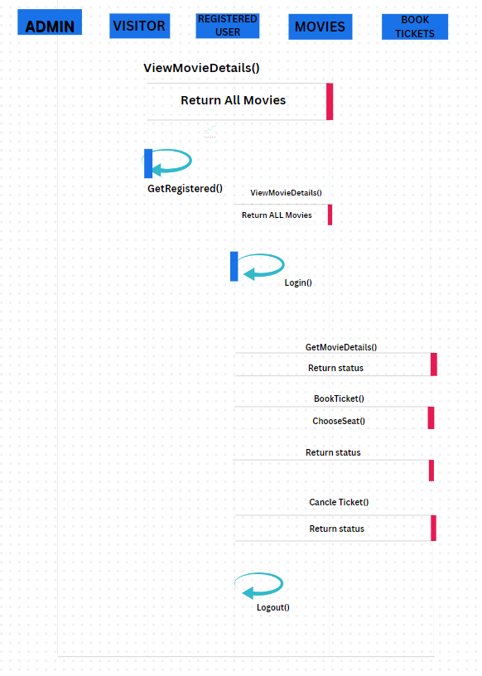
Sequence Diagram For User flow

Slide 19
Challenges Faced
Designing the system to work well when users try to book or cancel movie tickets.
Creating a system where users can book tickets for multiple seat types
Creating a system that is easy to use while still having all the features users need.
Implementing all the required validations.

Slide 20
FUTURE ENHANCEMENTS
Allowing users to receive otp to the email id when user registers
Allowing users to login to the platform without password
Realtime payment method
Users will be able to update the booking details

Slide 21
CONCLUSION
In conclusion, the Multiplex Booking System project is to enhance the experience of movie ticket reservation process. The system not only guarantees convenience by facilitating online bookings but also furnishes movie schedules, simplifies seat selection with ease. Moreover, its embedded analytics offer invaluable insights into costumer behavior.

Slide 22
Thank you

